Slide 1
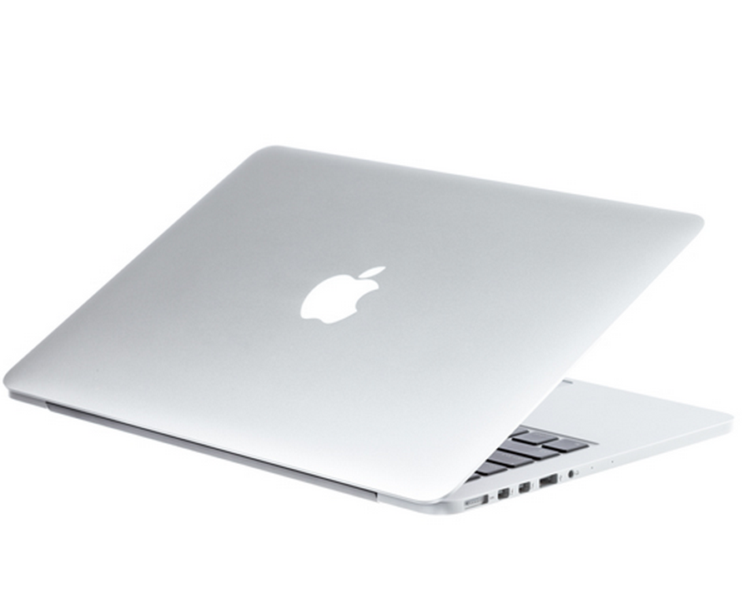
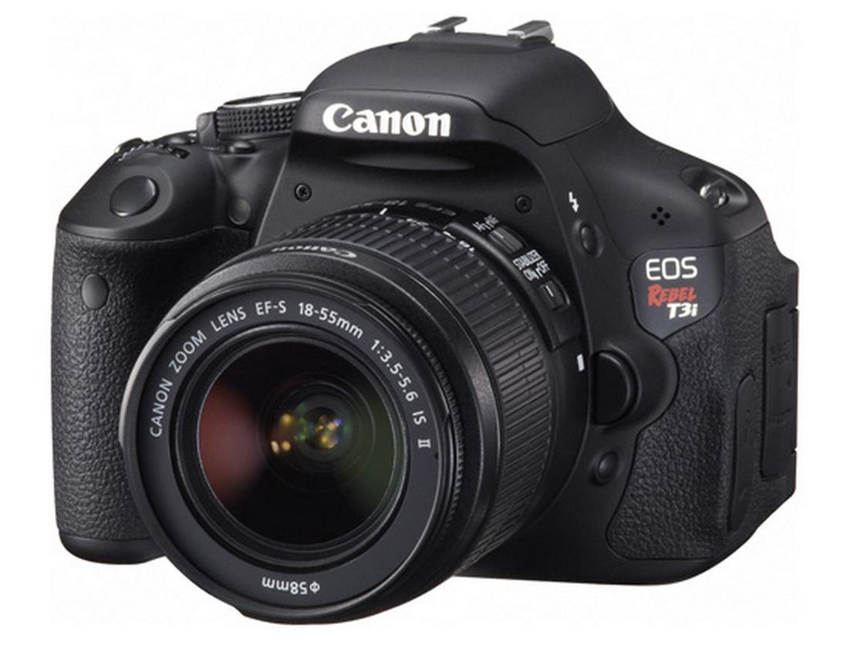
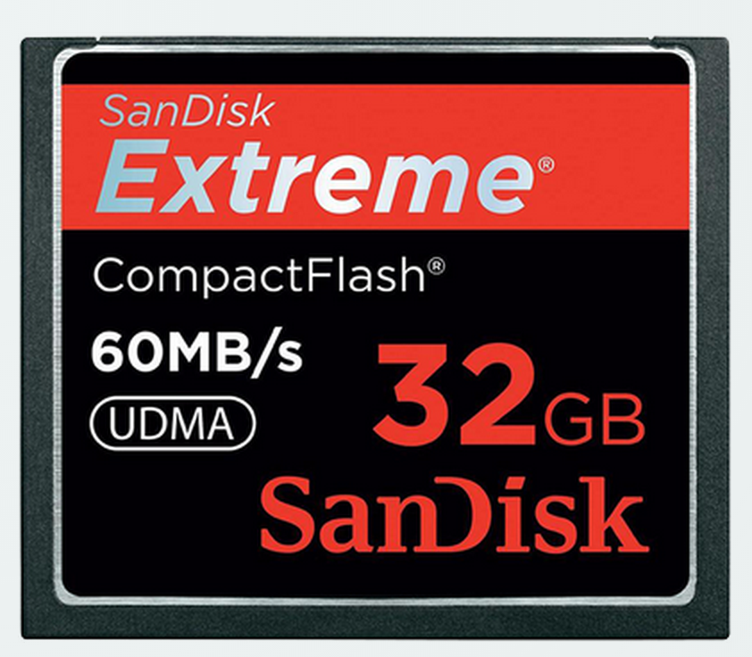
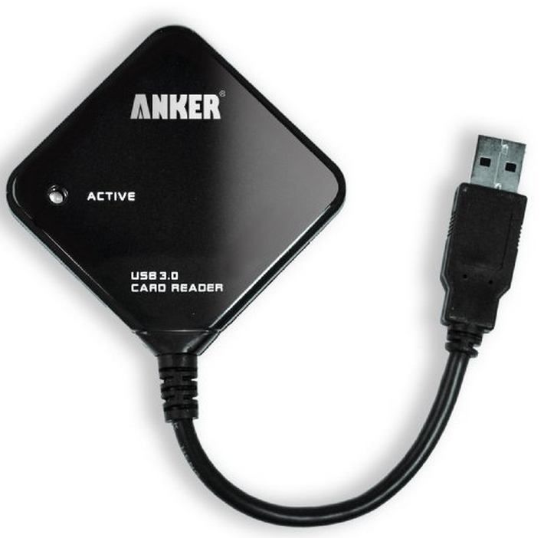
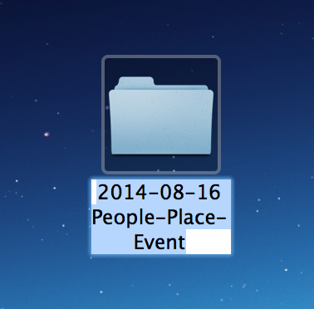
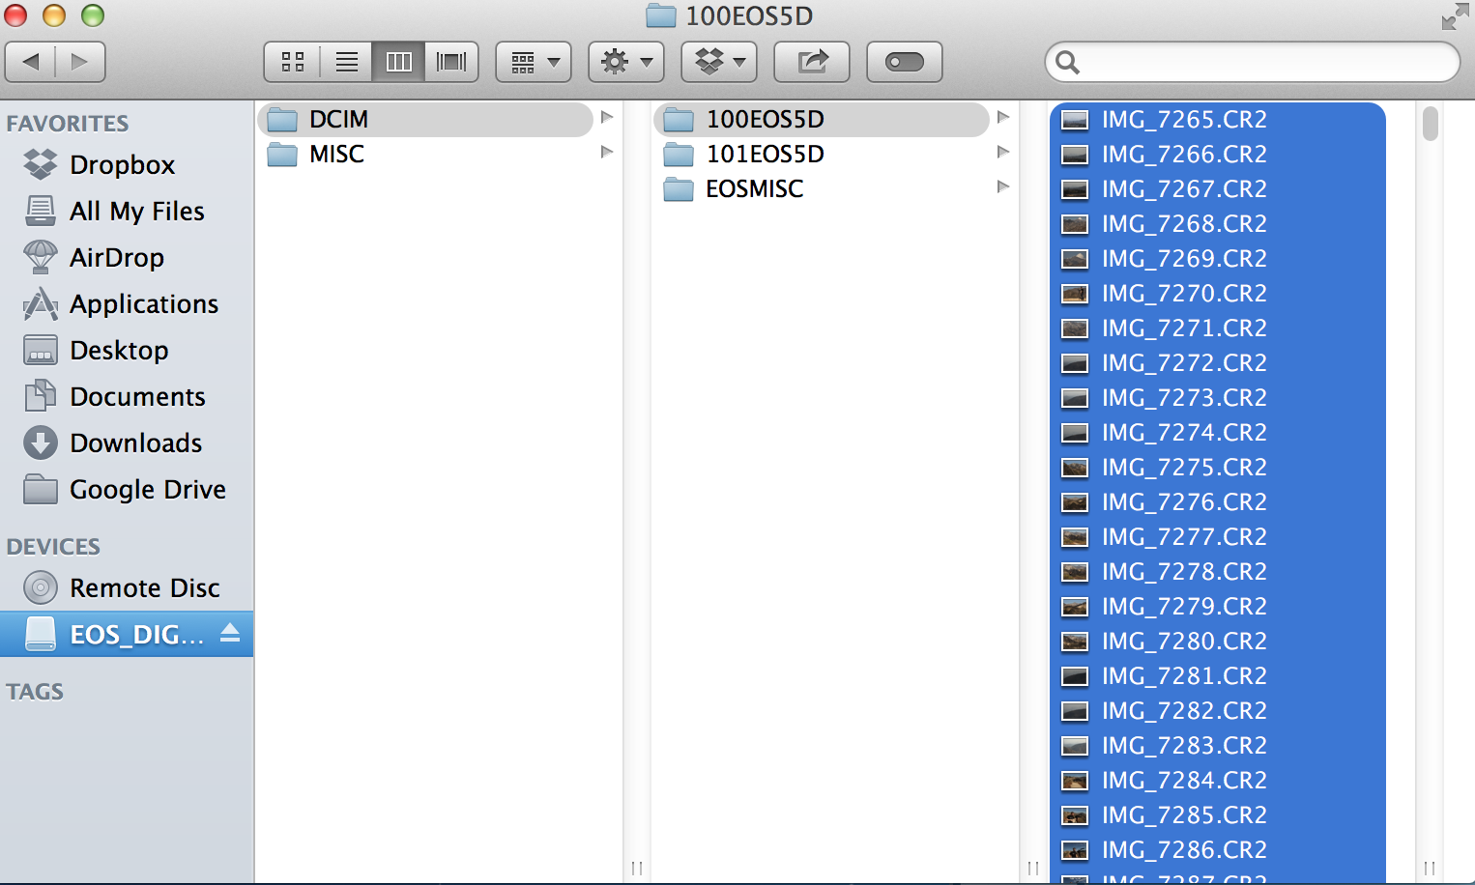
Basic Flow: Camera to Laptop
1. Take Pictures
2. Remove memory card +
place into memory card reader
3. Plug memory card
Reader into laptop
Or use computer’s card reader
4. Create new folder on desktop:
Name it with Event name + Place (location)
+ the date
5. Copy (don’t move) entire folder of images
into your new folder

Slide 2
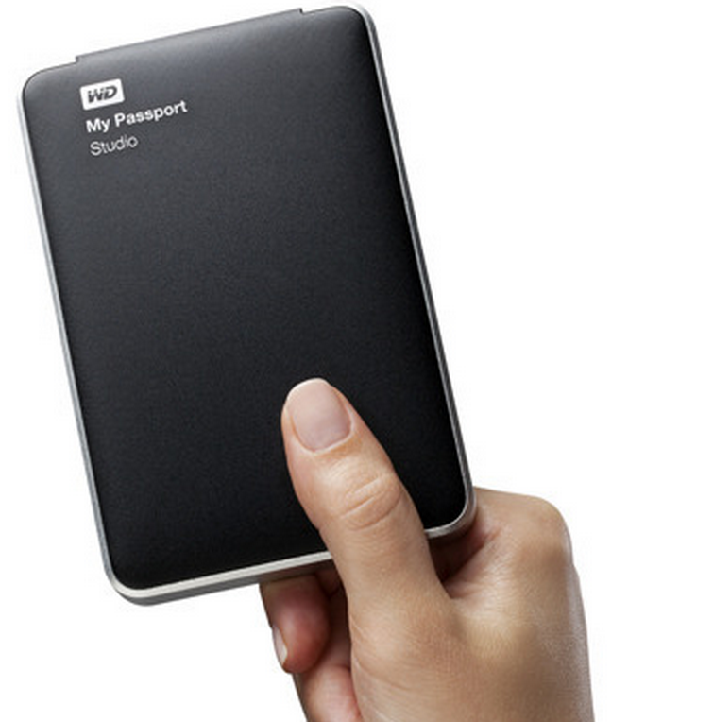

Basic Flow: Laptop to Backup
Before you edit:
Backup folder onto
a hard drive
Copy onto a second
Hard drive. * If you
Want to be extra
Careful. Store this in
Another location
Depending on how
Many pictures you
Took, upload to
An online storage site
Like Google Drive

Slide 3
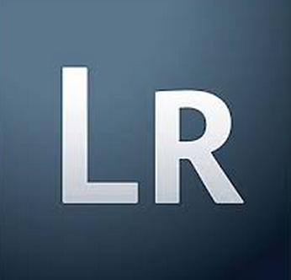
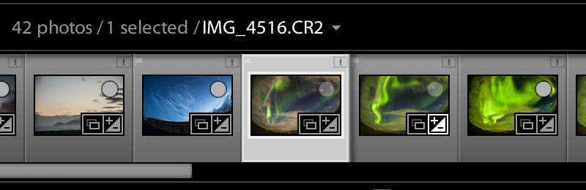
Basic Flow: Edit To Slideshow
Now that you have the original files backed up, you can edit your pictures as you like
And never worry about destroying or losing the original files.
Open Adobe Lightroom
And import your folder
In “Develop” mode, as you find
And edit the pictures you like, click on the top
Right of an image and you will get a little grey
Circle, which means this photo has been put into
The “Quick Collection”

Slide 4
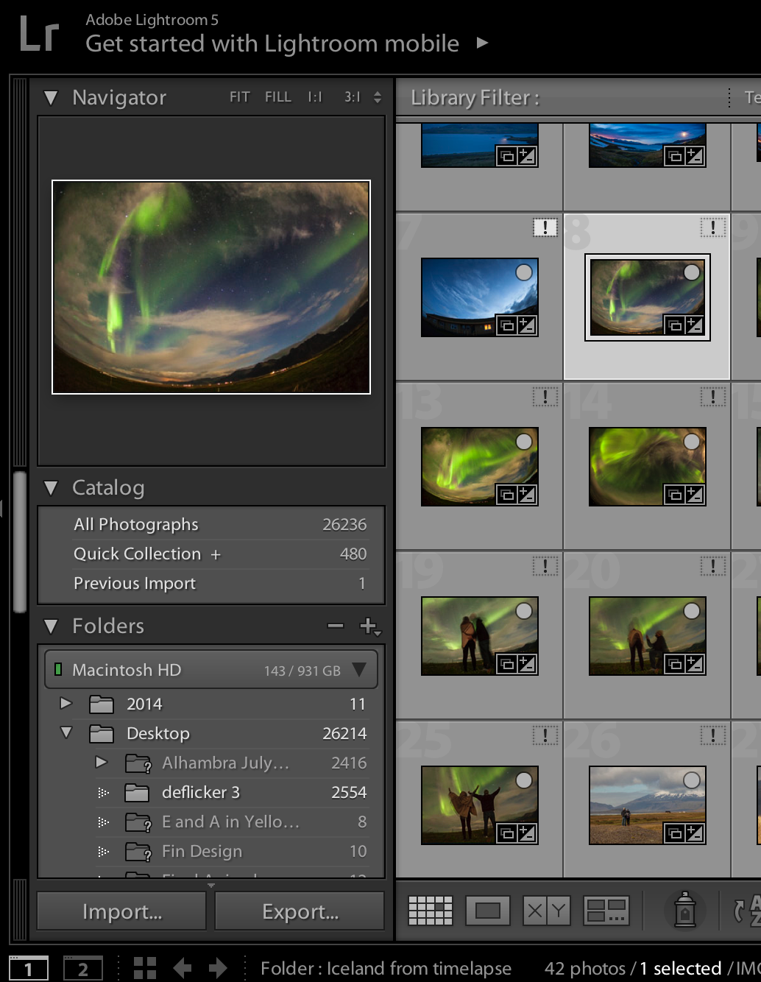
Basic Flow: Edit To Slideshow
After you have edited the pictures you like
And put those into the “quick collection”
You can then click on the “Library” tab.
On the left hand side, you will see a tab
Called “quick collection” under “catalog”
Click on that.
Then select the pictures you have edited
And click on “Export”
Select all the features you want and export
To a folder called “Event, Place, Date, Slideshow”
You will now have a slideshow

Slide 5
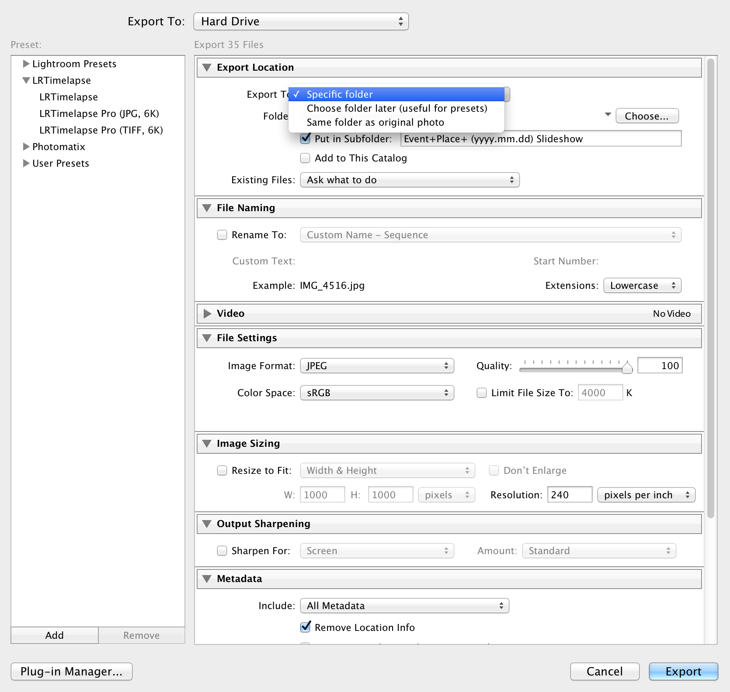
Basic Flow: Edit To Slideshow

Slide 6
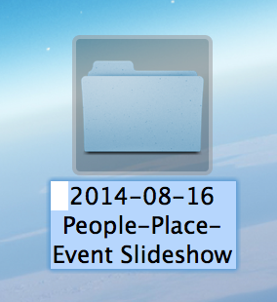



Basic Flow: Share + Backup Slideshow
Copy Slideshow to Same Hard Drives as your
Unprocessed pictures
Upload Slideshow to your favorite online
Storage site.

